Slide 1

Visualising the Impact of Covid-19
Dennis Chen (n12150801)
MXB362 Advanced Data Visualisation and Data Science Case Study Presentation

Slide 2
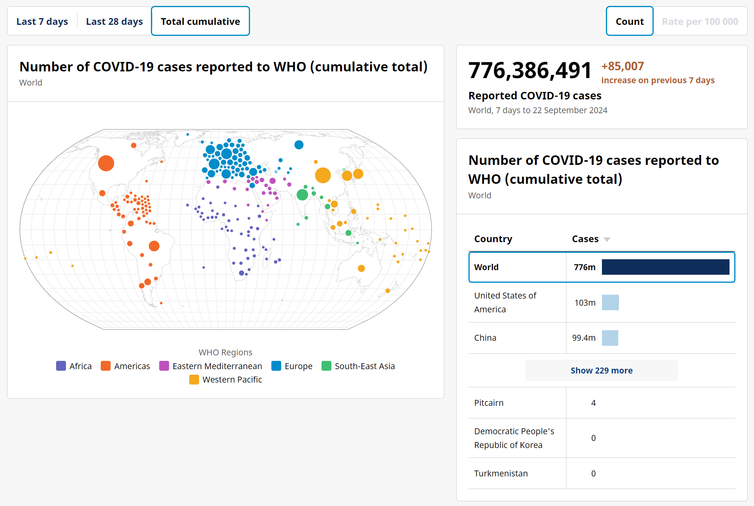
CURRENT PANDEMIC VISUALISATIONS
Most Visualisations of Covid-19
Provide total case numbers
Regional Breakdowns
Good for providing a quantitative overview of the pandemic.
However, they often fail to communicate the urgency or real-time severity of the situation to the general public.
Fig 1. WHO Covid-19 Dashboard (World Health Organization, n.d.)

Slide 3

Case Study Motivations
Develops a visualisation tool that delivers up-to-date, daily insights on the local spread of the pandemic
The tool should be user-friendly, making it easy for the public to understand current risks and trends in their area.
Empower them to make informed decisions.

Slide 4
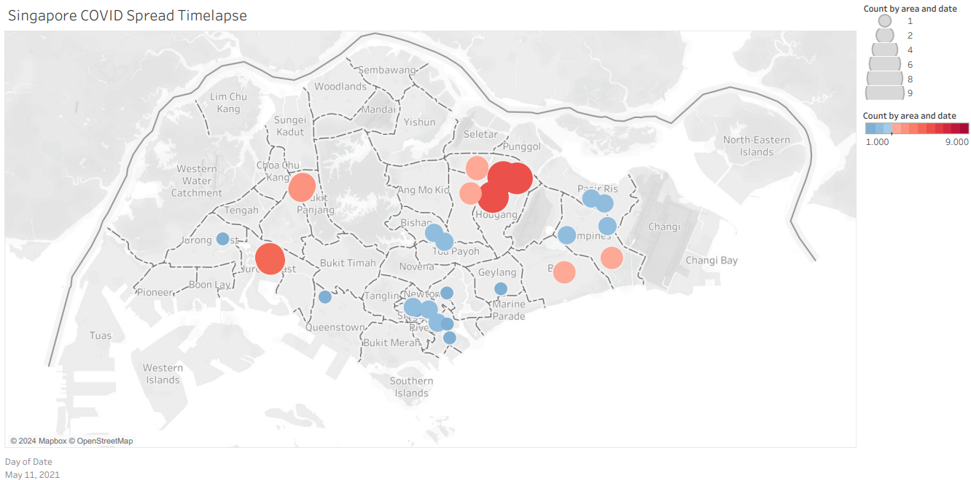
VISUALISING SG COVID-19 SPREAD (Singapore example)
This visualisation is an animation that shows the daily distribution of COVID-19 cases in Singapore
Unable to tell how increase of cases affects increase in size of circle
Circle is so big that it covers the entire district, mislead audience to think the entire estate is a hotspot
Unnecessary usage of 2 colours
Fig 2. Singapore COVID Spread Book (Chua, 2021)

Slide 5

Data source
The dataset used is a list that includes public places COVID-19 cases had visited for more than 30 minutes (Chua, 2020).
The main data that will be visualised is the following:
Time
Date
Latitude and Longitude Coordinates
Area (Estate names)
Dataset used: SG Covid Locations (SG-COVID-LOCATIONS, 2021)

Slide 6
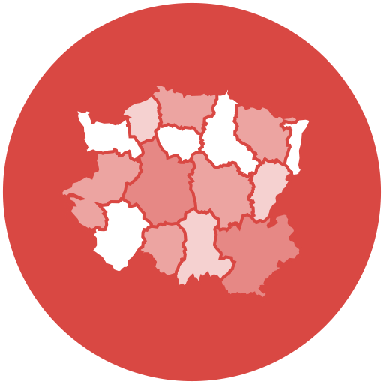
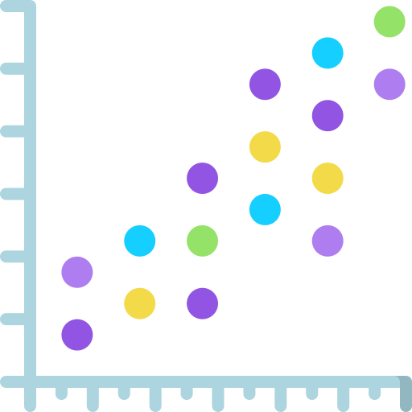
Visualisation Techniques and tools
Technique 1: Choropleth Map
Technique 2: Scatter Plot
Tools used
Data Manipulation: R
Visualisation: Python
Development on: Jupyter Notebook
Video Editing: Microsoft Clipchamp

Slide 7

Background research
Self-monitoring for up to 5 days is advised for close contacts of potential COVID-19 cases (Gov.SG | Updates to Health Protocols, n.d.).
Following government protocols, the produced visualisation should be an animation displaying COVID-19 case locations over a 5-day period.

Slide 8
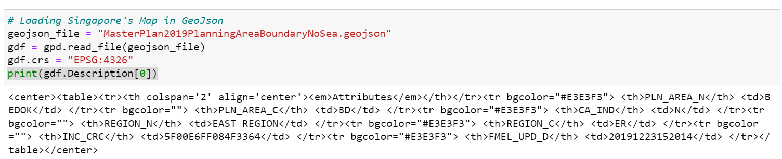


Results and Outputs
Data Manipulations
Extracting Relevant Information from GEOJson ‘Description’ field
Merged location data with geographic boundaries data based on area names.
Aggregated data by date and name, counting occurrences

Slide 9
Results and Outputs
Visualisation Technique 1: Animated Choropleth Map (Matplotlib)
Used Matplotlib to produce visualisation instead of other libraries that offer more interactivity.
Interactive elements like zooming, panning, and hovering over data points are not necessary when target audience is the general public whose primary need is to understand the spread and density.
Fig 3. SG Covid-19 Choropleth Map Animation

Slide 10
Results and Outputs
Visualisation Technique 2: Animated Scatter Plot (Matplotlib)
Experimented with different ways to animate with the locations of COVID-19 cases across Singapore
Sequential Animation of Individual Cases
Rolling 5-Day Window Animation of Individual Cases
Rolling 5-Day Window Animation of Daily Cases
Fig 4. SG Covid-19 Scatter Plot Animation (Method 3)

Slide 11
Results and Outputs
Combination of Both Technique
Fig 5 . SG Covid-19 Combination of Techniques

Slide 12
Exegesis of the Effectiveness of Visualisation Outputs
Lines Used thin lines to separate different areas of Singapore
Colours Used of monochromatic colour scheme
Clear Labels Clear and concise labels, limited to the legend and a title indicating the cumulative COVID-19 cases and the corresponding date.
Negative Space Use of negative space to ensure that the visualisation stands out
Minimised Complexity Minimises complexity by focusing solely on essential elements: the geographic areas, the cumulative case counts, and the date.

Slide 13


Problems
Initial animation frames show misalignment between the scatter plot and choropleth map. Potential cause: mismatch between the initial dataset and the GIS map of Singapore.
Simplified focus on Singapore’s geographic areas, case counts, and date makes the visualisation suitable for local audiences. Limits effectiveness for international viewers who may not recognize specific areas or districts.

Slide 14

Future work
Incorporate live feeds from reliable sources (health organisations and government databases).
Integrate real-time data into the visualisation tool to enhance relevance and usability during pandemics.

Slide 15
References
World Health Organization. (n.d.). COVID-19 cases | WHO COVID-19 dashboard. data.who. https://data.who.int/dashboards/covid19/cases
Chua, H. X. (2021, June 30). Data VIS Singapore Jun 2021 MeetUp: Visualising SG COVID-19 Spread [Video]. YouTube. https://www.youtube.com/watch?v=OFRegA91bAM
Chua, H. S. (n.d.). GitHub - huishun98/SG-COVID-data-automated: This project prepares data for a visualisation showing the spread of COVID-19 in Singapore across time. GitHub. https://github.com/huishun98/SG-COVID-data-automated?tab=readme-ov-file
Chua, H. S. (2021, June 5). Singapore COVID Spread Book. Tableau Public. https://public.tableau.com/app/profile/hui.shun/viz/SingaporeCOVIDSpreadBookAutoUpdate/Dashboard
Chua, H. X. (2020, May 30). Public Places Visited by Singapore Covid-19 Cases. data.world. https://data.world/hxchua/public-places-visited-in-singapore-by-covid-19-cases
SG-COVID-Locations. (n.d.). Google Docs. https://docs.google.com/spreadsheets/d/19EPRvGyAMnYZn9LwfFa4UqYrt-MQ94-qEUg76vbl2Gs/edit?gid=0#gid=0
Gov.SG | Updates to health protocols. (n.d.). Default. https://www.gov.sg/article/updates-to-health-protocols
MXB362. (n.d.). Google Docs. https://docs.google.com/spreadsheets/d/1ZSmeVb8H-TFp9U5e9KdF5GGieY2Bom53Z6UJeNp_jmw/edit?usp=sharing
Urban Redevelopment Authority [URA]. (2024, June). Master Plan 2019 Planning Area Boundary (No Sea). data.gov.sg. https://data.gov.sg/datasets/d_4765db0e87b9c86336792efe8a1f7a66/view

